Slide 1

SYS.OP.PARKINSONS_CLASSIFIER // V.1.0
CONFIDENTIAL
Technical Design Document
Quantitative Motor Assessment: SVM-Based Classification of Parkinson's via Finger-Tapping Signal Analysis
A framework for moving from subjective observation to objective, quantifiable motor function evaluation.
DOC_ID: PK_SVM_2026
PAGE 01/12

Slide 2
PROBLEM_STATEMENT // SUBJECTIVE_VS_OBJECTIVE
CONFIDENTIAL
From Subjective to Objective Assessment
CURRENT STATE: SUBJECTIVE
TARGET STATE: OBJECTIVE
Clinical Observation: Diagnosis relies on visual assessment of motor tasks.
Digital Quantification: Precise measurement of Bradykinesia (slowness) and Hypokinesia (small movements).
→
Limitations: High variability between clinicians; difficult to track subtle progression over time.
Benefits: Standardized, reproducible metrics for consistent longitudinal tracking.
> STATUS: QUALITATIVE > ERROR_RATE: HIGH > REPRODUCIBILITY: LOW
> STATUS: QUANTITATIVE > ERROR_RATE: MINIMIZED > REPRODUCIBILITY: HIGH
DOC_ID: PK_SVM_2026
PAGE 02/12

Slide 3
DATA_INPUT // UNSTRUCTURED_TIME_SERIES
CONFIDENTIAL
Processing Unstructured Signals
Input Source: Raw finger-tapping data captured from sensor arrays.
> INCOMING_STREAM_01: [120, 125, 118, 130, 122, 119, ...] > INCOMING_STREAM_02 (TIMESTAMP): [0.05, 0.12, 0.18, 0.25, 0.33, ...] > STATUS: UNPROCESSED > FORMAT: STRING > ENCODING: UTF-8 > SYSTEM_NOTE: Data is raw and requires immediate parsing. > ... > ... > END_OF_STREAM
RAW_DATA_STREAM // INPUT_LOG
KEY CHARACTERISTICS:
1. Unstructured Strings: Data arrives as continuous streams, not static tables.
2. Two Primary Signals: - Amplitude: Magnitude of movement. - Time: Temporal spacing (rhythm).
> CHALLENGE: Variable trial lengths & sensor noise. > REQUIREMENT: Must parse & structure before analysis.
DOC_ID: PK_SVM_2026
PAGE 03/12

Slide 4

SIGNAL_STANDARDIZATION // 1800_POINT_LOGIC
CONFIDENTIAL
1,800-Point Padding Logic
Objective: Machine learning models require fixed-length input vectors. Raw trial data varies in duration.
The Standard: All signals are standardized to exactly 1,800 points.
SCENARIO A: SHORT SIGNAL (< 1800)
1800 PTS
RAW DATA
PADDING (000...)
Implementation Logic:
>
Padded with zeros or interpolated values to reach length.
Short Trials:
SCENARIO B: LONG SIGNAL (> 1800)
1800 PTS
>
RAW DATA (TRUNCATED)
Truncated or resampled to fit the standard window.
Long Trials:
* Excess data discarded
> RESULT: UNIFORM DIMENSIONALITY > READY_FOR: SVM_PIPELINE
DOC_ID: PK_SVM_2026
PAGE 04/12

Slide 5

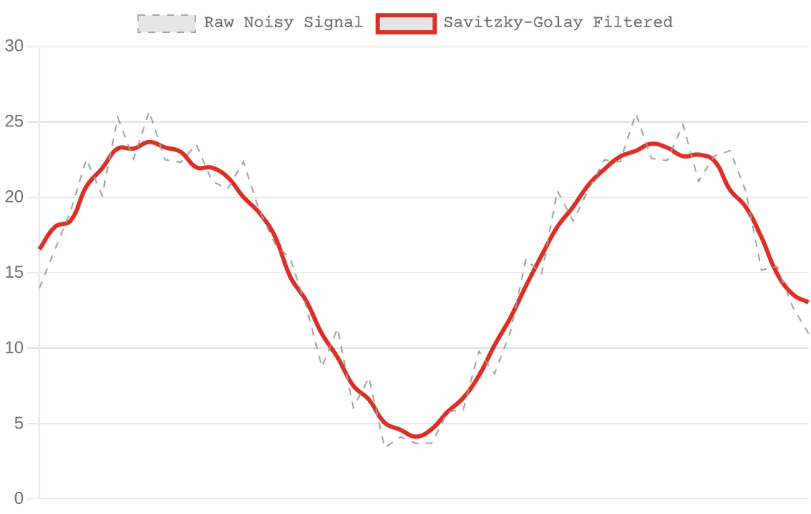
NOISE_REDUCTION // SAVITZKY_GOLAY_FILTER
CONFIDENTIAL
Savitzky-Golay Filter Implementation
The Challenge: Raw sensor data is plagued by high-frequency jitter and measurement artifacts that can obscure true motor patterns.
FIG 2.1: SIGNAL SMOOTHING
Why Savitzky-Golay?
Unlike simple moving averages which blunt signal peaks, this polynomial smoothing filter preserves the diagnostic integrity of peak heights and widths.
Technical Benefit
Maintains the sharp transitions required to accurately calculate velocity and inter-tap intervals.
DOC_ID: PK_SVM_2026
PAGE 05/12

Slide 6
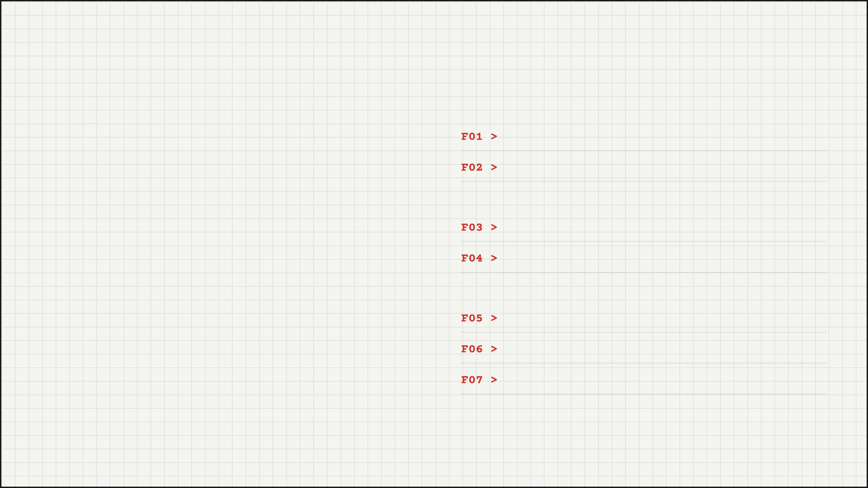
FEATURE_EXTRACTION // QUANTITATIVE_METRICS
CONFIDENTIAL
Seven Quantitative Motor Metrics
AMPLITUDE METRICS (HYPOKINESIA)
Mean Amplitude
[μ]
METHODOLOGY
> scipy.signal.find_peaks
Std Dev Amplitude
[σ]
> PARAMETERS: height=None, distance=15
> OUTPUT: Peak Indices & Properties
TIMING METRICS (BRADYKINESIA/RHYTHM)
By identifying individual finger taps using peak detection algorithms, we transform continuous signals into discrete events. This allows for the calculation of statistical moments that describe motor performance.
Mean Inter-Tap Interval
[μ]
Std Dev Inter-Tap Interval
[σ]
KINETIC METRICS
Velocity (Amp/Time)
[v]
Acceleration Profile
[a]
Fatigue Decrement
[Δ]
DOC_ID: PK_SVM_2026
PAGE 06/12

Slide 7
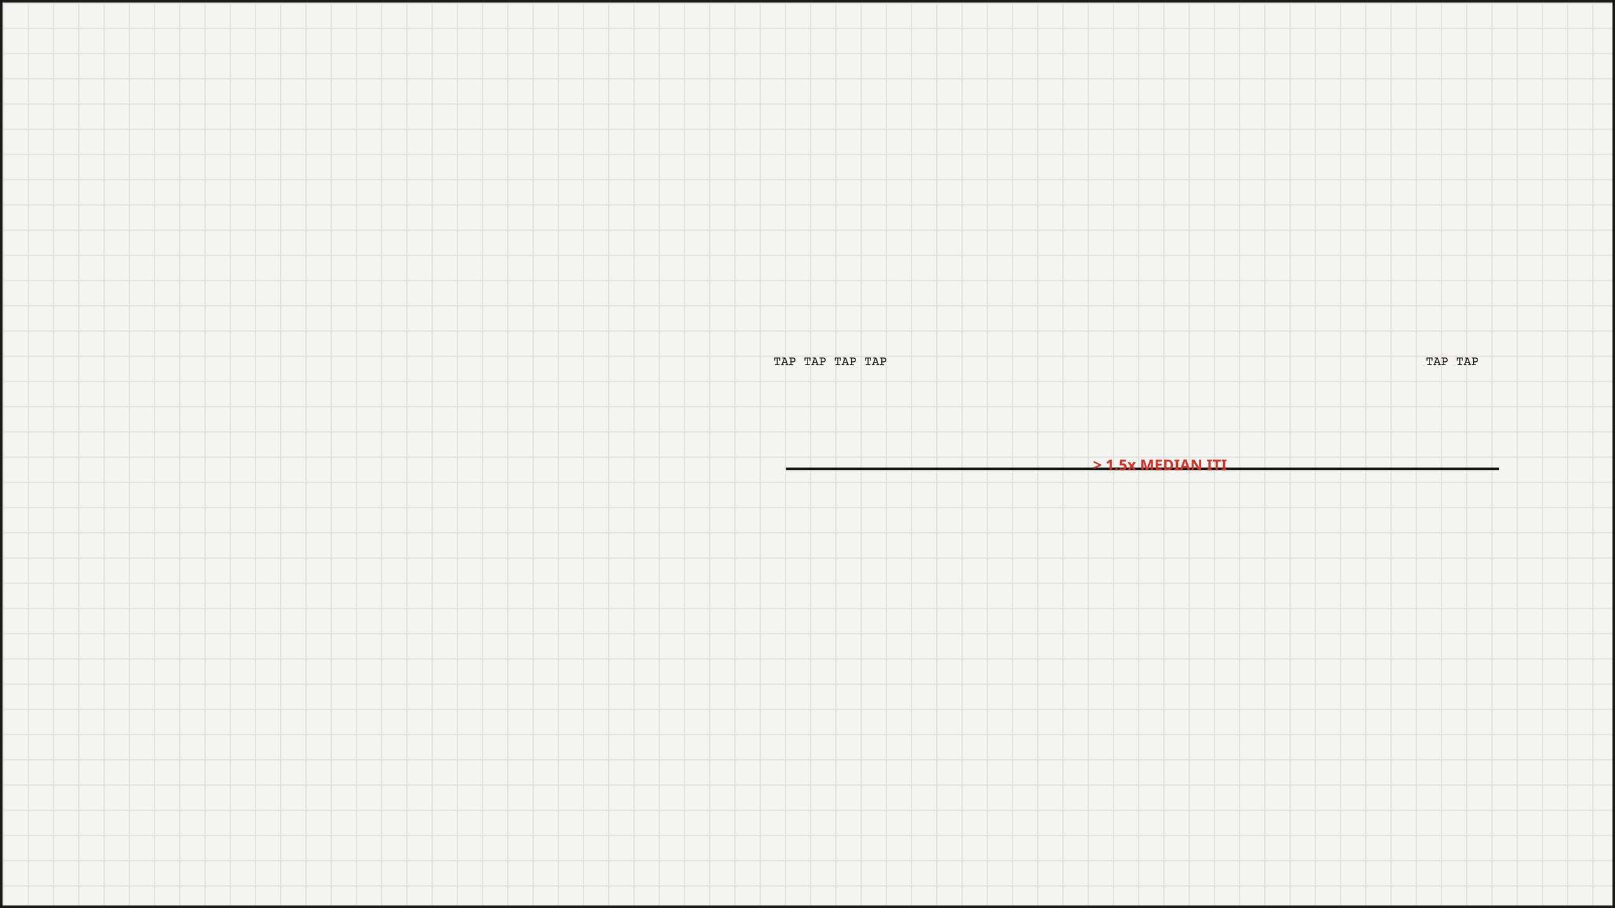
ALGORITHM // FREEZING_DETECTION
CONFIDENTIAL
Detecting Freezing: The "Long Pause"
IF (ITI > 1.5 * Median_ITI)
SIGNAL_VISUALIZATION // TAP_STREAM
Motor Freezing: A hallmark symptom of Parkinson's, characterized by a sudden inability to initiate or continue movement.
TAP
TAP
TAP
TAP
TAP
TAP
FREEZING DETECTED
Digital Biomarker: We identify "Long Pauses" as inter-tap intervals (ITI) that statistically exceed the patient's baseline rhythm.
> 1.5x MEDIAN ITI
Visual Logic: Regular rhythmic tapping is interrupted by a pause exceeding the adaptive threshold, triggering a positive detection event.
> STATUS: CRITICAL_BIOMARKER > METHOD: ADAPTIVE_THRESHOLDING > RESULT: QUANTIFIABLE_EVENT_COUNT
DOC_ID: PK_SVM_2026
PAGE 07/12

Slide 8

THE_MODEL // SVM_ARCHITECTURE
CONFIDENTIAL
Linear SVM Architecture
01. Linear Support Vector Machine
RAW FEATURE VECTOR
Chosen for high interpretability and robust performance on small-to-medium datasets. The linear kernel allows direct inspection of feature importance.
↓
02. Integrated StandardScaler
STANDARD SCALER (Normalization)
Features are normalized to zero mean and unit variance within the pipeline. This prevents features with larger scales (e.g., Amplitude) from dominating the objective function.
↓
03. Probabilistic Output
LINEAR SVM (Hyperplane Separation)
Instead of binary hard classification, the model outputs probability scores (0.0 to 1.0), enabling the "Uncertainty Band" logic.
↓
pipeline = Pipeline([ ('scaler', StandardScaler()), ('svm', SVC(kernel='linear', probability=True)) ])
PROBABILITY SCORE (0.0 - 1.0)
DOC_ID: PK_SVM_2026
PAGE 08/12

Slide 9
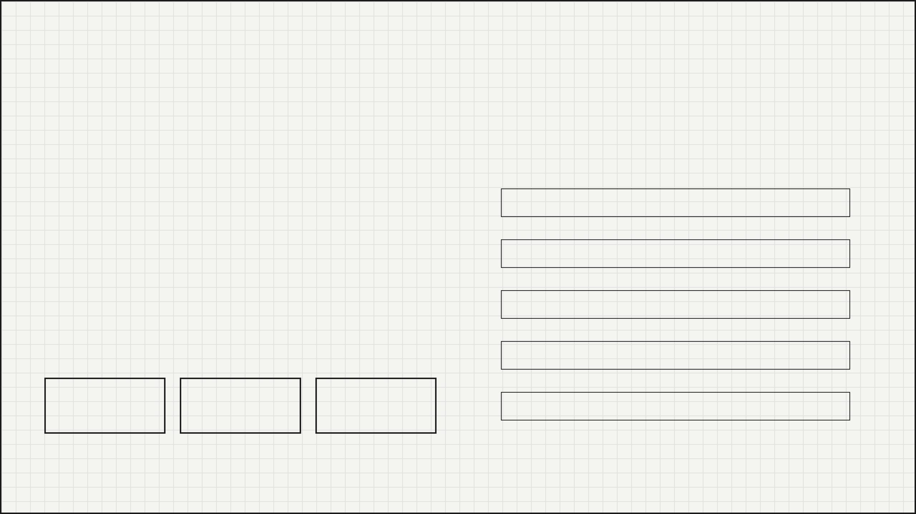
VALIDATION // STRATIFIED_K_FOLD
CONFIDENTIAL
Stratified K-Fold Cross-Validation
Objective: Ensure the model generalizes to unseen patients and is not overfitting to specific training data.
DATA PARTITIONING VISUALIZATION
Why Stratified? Parkinson's datasets are often imbalanced. Stratification ensures that the ratio of Positive to Negative cases is preserved in every fold, preventing biased training.
ITERATION 1
TEST
TRAIN
TRAIN
TRAIN
TRAIN
ITERATION 2
TRAIN
TEST
TRAIN
TRAIN
TRAIN
ITERATION 3
> METHOD: 5-FOLD CROSS-VALIDATION > SPLIT: 80% TRAIN / 20% TEST > ITERATIONS: 5 ROTATIONS
TRAIN
TRAIN
TEST
TRAIN
TRAIN
ITERATION 4
TRAIN
TRAIN
TRAIN
TEST
TRAIN
ACC
SENS
SPEC
ITERATION 5
TRAIN
TRAIN
TRAIN
TRAIN
TEST
Accuracy
Sensitivity
Specificity
DOC_ID: PK_SVM_2026
PAGE 09/12

Slide 10

DUAL_MODEL_SYSTEM // LATERALIZED_CLASSIFICATION
CONFIDENTIAL
Hand-Specific Classification
SERIALIZED_MODEL
SERIALIZED_MODEL
svm_left.pkl
svm_right.pkl
Target: Non-dominant hand motor patterns. Training Data: Exclusively left-hand trials. Purpose: Detects subtle bradykinesia in the left limb, often the site of initial onset.
Target: Dominant hand motor patterns. Training Data: Exclusively right-hand trials. Purpose: Accounts for higher baseline dexterity and different fatigue profiles.
Why Two Models?
Parkinson's disease typically presents with unilateral symptom onset. A single global model would average out these asymmetries, potentially missing early-stage indicators that appear on only one side of the body.
DOC_ID: PK_SVM_2026
PAGE 10/12

Slide 11
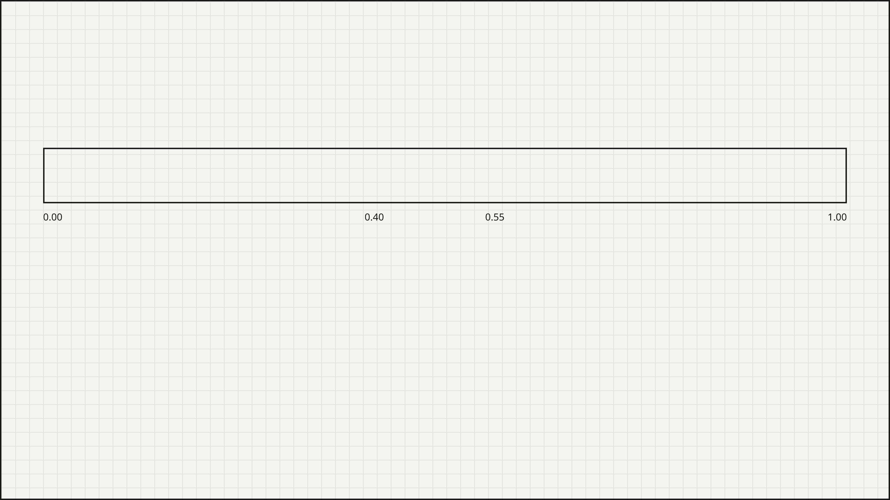
SAFETY_LOGIC // UNCERTAINTY_BAND
CONFIDENTIAL
The Uncertainty Band
PROBABILITY OUTPUT SPECTRUM (0.0 - 1.0)
NEGATIVE
UNCERTAIN
POSITIVE
Zone 1: Negative
Zone 2: Inconclusive
Zone 3: Positive
Prob < 0.40
0.40 ≤ Prob ≤ 0.55
Prob > 0.55
Model predicts low likelihood of Parkinsonian motor symptoms. Consistent with healthy control data.
The "Safety Buffer". Signal is ambiguous. Prevents false positives/negatives in borderline cases.
High likelihood of Parkinsonian features (bradykinesia/freezing) detected in the signal.
ACTION: DISMISS
ACTION: CLINICIAN REVIEW
ACTION: FLAG FOR DIAGNOSIS
DOC_ID: PK_SVM_2026
PAGE 11/12

Slide 12
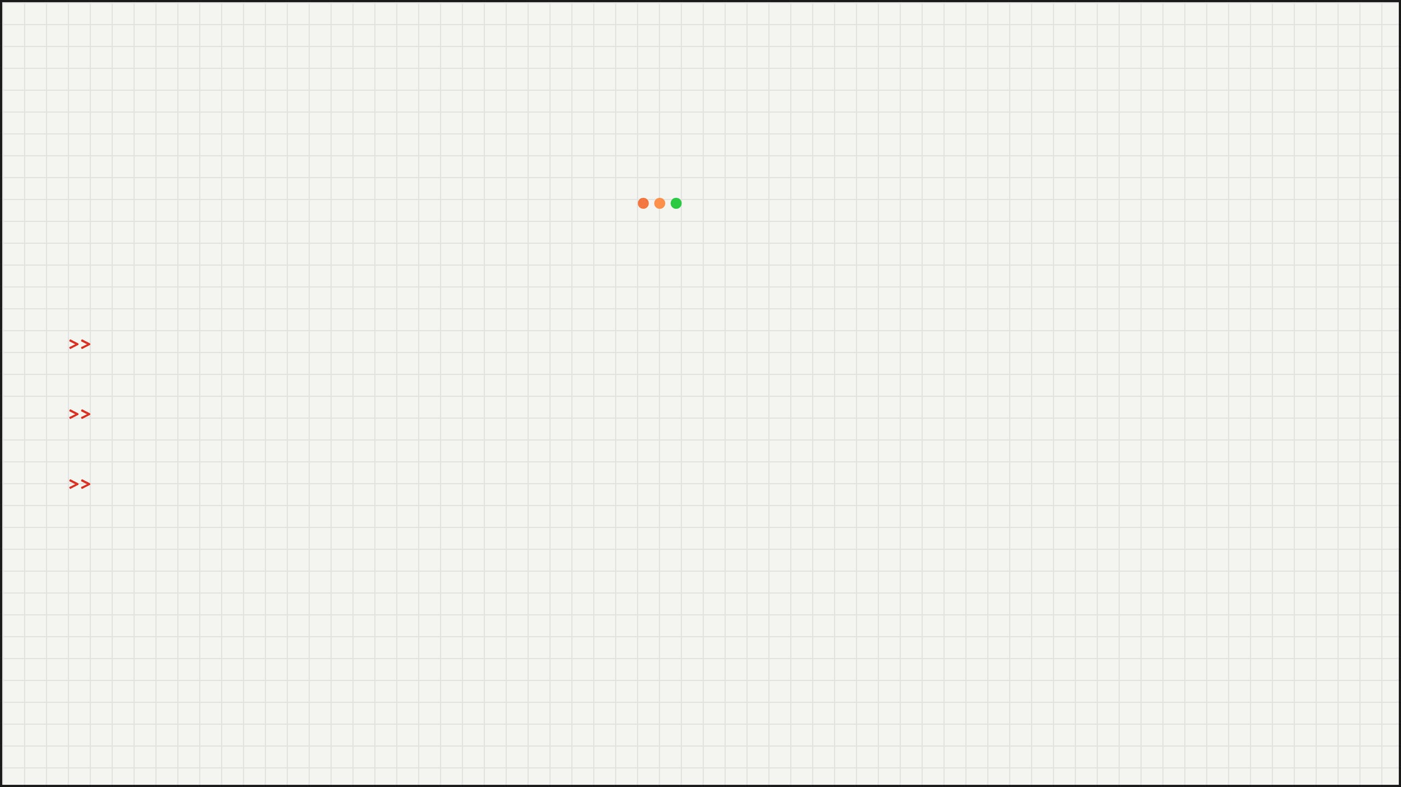
DEPLOYMENT // STREAMLIT_INTERFACE
CONFIDENTIAL
Streamlit Clinical Interface
The app.py module provides a secure, lightweight web interface for immediate clinical use.
localhost:8501/parkinsons_classifier
Parkinson's Signal Classifier v1.0
Clinicians paste raw time-series strings directly from sensor logs.
RAW SIGNAL INPUT:
Input:
[120, 124, 118, 130, 122, 119, 125, 121, 118, 120...]
Process:
Backend pipeline executes padding, filtering, and SVM classification.
Instant diagnostic suggestion with safety flags.
ANALYZE SIGNAL
Output:
> DEPLOYMENT_MODE: LOCAL / CLOUD > LATENCY: < 200ms > ROLE: DECISION_SUPPORT
PREDICTION:
POSITIVE
PROBABILITY:
0.82
STATUS: HIGH CONFIDENCE (> 0.55)
DOC_ID: PK_SVM_2026
PAGE 12/12

